Slide 1
Computer Organization and Architecture
Chapter 2
Computer Evolution and Performance

Slide 2
First Generation
ENIAC: Electronic Numerical Integrator And Computer
Decimal (not binary)
20 accumulators of 10 digits
Programmed manually by switches
18,000 vacuum tubes
30 tons
15,000 square feet

Slide 3
Transistor Based Computers
Transistors replaced vacuum tubes
Smaller
Cheaper
Less heat dissipation
Solid State device
Made from Silicon (Sand)
Invented 1947 at Bell Labs
William Shockley et al.

Slide 4
Microelectronics Based Computers
Literally - “small electronics”
A computer is made up of gates, memory cells and interconnections
These can be manufactured on a semiconductor
e.g. silicon wafer

Slide 5
Generations of Computer
Vacuum tube - 1946-1957
Transistor - 1958-1964
Small scale integration - 1965 on
  Up to 100 devices on a chip
Medium scale integration - to 1971
  100-3,000 devices on a chip
Large scale integration - 1971-1977
  3,000 - 100,000 devices on a chip
Very large scale integration - 1978 -1991
  100,000 - 100,000,000 devices on a chip
Ultra large scale integration – 1991 -
  Over 100,000,000 devices on a chip

Slide 6
Moore’s Law
Increased density of components on chip
Gordon Moore – co-founder of Intel
Number of transistors on a chip will double every year
Since 1970’s development has slowed a little
  Number of transistors doubles every 18 months
Cost of a chip has remained almost unchanged
Higher packing density means shorter electrical paths, giving higher performance
Smaller size gives increased flexibility
Reduced power and cooling requirements
Fewer interconnections increases reliability

Slide 7
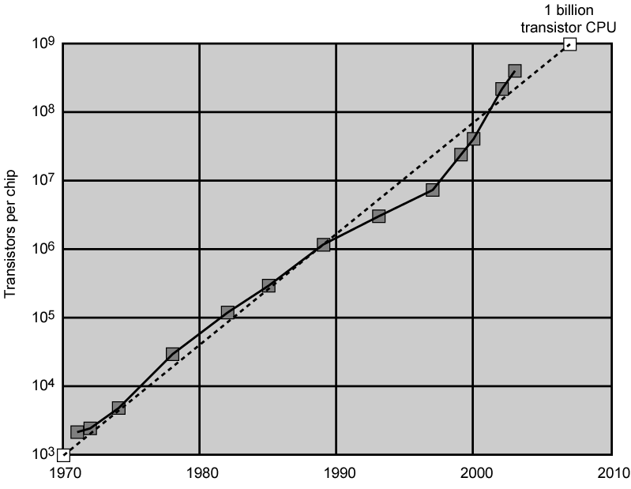
Growth in CPU Transistor Count

Slide 8
Von Neumann
Stored Program concept
Main memory storing programs and data
ALU operating on binary data
Control unit interpreting instructions from memory and executing
Input and output equipment operated by control unit
Princeton Institute for Advanced Studies
  IAS
Completed 1952

Slide 9

Structure of von Neumann machine

Slide 10
IAS - details
1000 x 40 bit words
  Binary number
  2 x 20 bit instructions
Set of registers (storage in CPU)
  Memory Buffer Register
  Memory Address Register
  Instruction Register
  Instruction Buffer Register
  Program Counter
  Accumulator
  Multiplier Quotient

Slide 11

Structure of IAS – detail

Slide 12
Performance Assessment
Clock Speed
Key parameters
  Performance, cost, size, security, reliability, power consumption
System clock speed
  In Hz or multiples of
  Clock rate, clock cycle, clock tick, cycle time
Signals in CPU take time to settle down to 1 or 0
Signals may change at different speeds
Operations need to be synchronised
Instruction execution in discrete steps
  Fetch, decode, load and store, arithmetic or logical
  Usually require multiple clock cycles per instruction
Pipelining gives simultaneous execution of instructions
So, clock speed is not the whole story

Slide 13
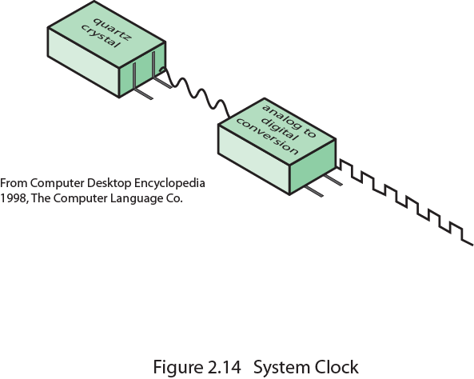
System Clock

Slide 14
Instruction Execution Rate
Millions of instructions per second (MIPS)
Millions of floating point instructions per second (MFLOPS)
Heavily dependent on instruction set, compiler design, processor implementation, cache & memory hierarchy

Slide 15
Benchmarks
Programs designed to test performance
Written in high level language
  Portable
Represents style of task
  Systems, numerical, commercial
Easily measured
Widely distributed
E.g. System Performance Evaluation Corporation (SPEC)
  CPU2006 for computation bound
    17 floating point programs in C, C++, Fortran
    12 integer programs in C, C++
    3 million lines of code
  Speed and rate metrics
    Single task and throughput

Slide 16

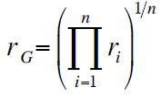
SPEC Speed Metric
Single task
Base runtime defined for each benchmark using reference machine
Results are reported as ratio of reference time to system run time
  Tref_{i} execution time for benchmark i on reference machine
  Tsut_{i} execution time of benchmark i on test system
Overall performance calculated by averaging ratios for all 12 integer benchmarks
  Use geometric mean
    Appropriate for normalized numbers such as ratios

Slide 17
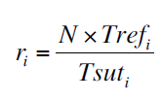
SPEC Rate Metric
Measures throughput or rate of a machine carrying out a number of tasks
Multiple copies of benchmarks run simultaneously
  Typically, same as number of processors
Ratio is calculated as follows:
  Tref_{i} reference execution time for benchmark i
  N number of copies run simultaneously
  Tsuti elapsed time from start of execution of program on all N processors until completion of all copies of program
  Again, a geometric mean is calculated

Slide 18
Amdahl’s Law
Gene Amdahl [AMDA67]
Potential speed up of program using multiple processors
Concluded that:
  Code needs to be parallelizable
  Speed up is bound, giving diminishing returns for more processors
Task dependent
  Servers gain by maintaining multiple connections on multiple processors
  Databases can be split into parallel tasks

Slide 19
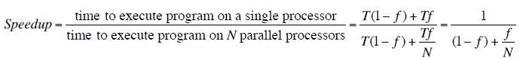
Amdahl’s Law Formula
For program running on single processor
  Fraction f of code infinitely parallelizable with no scheduling overhead
  Fraction (1-f) of code inherently serial
  T is total execution time for program on single processor
  N is number of processors that fully exploit parralle portions of code
Conclusions
  f small, parallel processors has little effect
  N ->∞, speedup bound by 1/(1 – f)
    Diminishing returns for using more processors

Slide 20
Internet Resources
http://www.intel.com/
  Search for the Intel Museum
http://www.ibm.com
http://www.dec.com
Charles Babbage Institute
PowerPC
Intel Developer Home

Slide 21
References
AMDA67 Amdahl, G. “Validity of the Single-Processor Approach to Achieving Large-Scale Computing Capability”, Proceedings of the AFIPS Conference, 1967.

